Slide 1


Project Name : Emotion Recognition from Text using BERT
Subject : Artificial Intelligence(AI101B)
By:-Sakshi Khandelwal
Priyanshu Asthana
Sanya Dwivedi
Project Supervisor:
Mr Apoorv Jain

Slide 2

Emotion Recognition from Text with BERT
Welcome to this presentation on Emotion Recognition from Text using BERT. We will explore how transformer models, particularly BERT, revolutionize sentiment analysis by understanding deep contextual meanings in text. This session covers the fundamentals, model architecture, evaluation methods, challenges, and future directions.
SK

Slide 3

Introduction to Emotion Recognition
Understanding Emotion Recognition
Practical Applications
This technology is widely used in customer service automation, market sentiment analysis, and social media trend tracking to decode user feelings efficiently.
Emotion recognition is analyzing text to identify the underlying sentiment or emotional state conveyed. It plays a vital role in interpreting human communication digitally.
Traditional vs. Modern Approaches
While traditional sentiment methods used rule-based or simple classifiers, modern deep learning methods, especially transformers like BERT, provide superior contextual understanding.

Slide 4
Background: Understanding BERT
What is BERT?
Transformer Architecture
Pre-training and Fine-tuning
BERT stands for Bidirectional Encoder Representations from Transformers. It captures context from both left and right in text sequences, enabling deep semantic understanding.
Built on attention mechanisms, transformers enable parallel processing of input sequences, empowering models to learn relationships between words independent of their position.
BERT is pre-trained on large corpora with masked language modeling and next-sentence prediction tasks, then fine-tuned on specific NLP tasks like emotion recognition for high accuracy.

Slide 5

Data and Preprocessing
Dataset Selection
Data Cleaning & Tokenization
Popular datasets for emotion recognition include GoEmotions and SemEval, offering a wide array of labeled emotional text for training robust models.
Cleaning removes noise and special characters while tokenization converts text into tokens understood by BERT using WordPiece or SentencePiece methods.
Data Preparation for BERT
Text is transformed into input IDs, attention masks, and token type IDs, ensuring BERT correctly processes sequential relationships and contextual importance.

Slide 6




Model Architecture and Fine-Tuning
Choosing Model Size
Adding Classification Layer
BERT-base offers a good balance of accuracy and efficiency, while BERT-large achieves higher performance at the cost of more computational resources.
A dense layer atop BERT outputs classifies text into emotional categories, enabling targeted sentiment detection.
1
2
Implementation Example
Fine-Tuning Strategy
4
Using Hugging Face’s Transformers library streamlines fine-tuning with modular code and pre-trained BERT models.
Optimizing learning rates, batch sizes, and epochs during fine-tuning improves model adaptability to emotion recognition tasks.
3

Slide 7
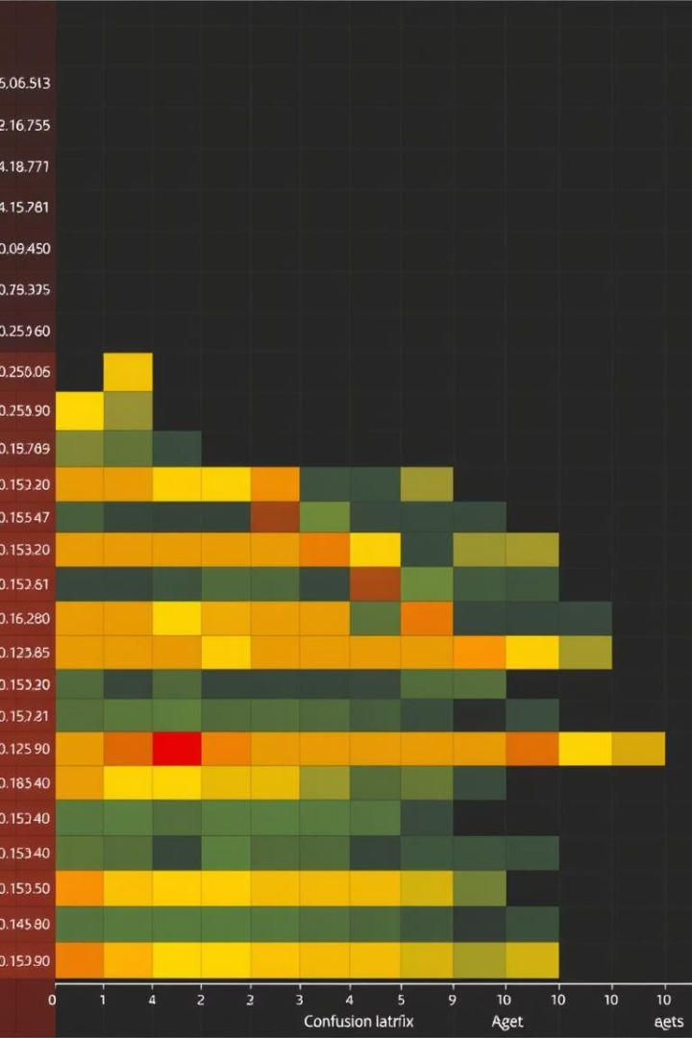
Evaluation Metrics
Standard Metrics
Accuracy, precision, recall, and F1-score evaluate classification effectiveness comprehensively across different emotion classes.
Confusion Matrix
Visualizing true vs. predicted labels identifies patterns in misclassifications, guiding model improvements.
Addressing Imbalanced Data
Strategies like resampling and weighted metrics help counteract class imbalance prevalent in emotion datasets.
Cross-Validation
Robust evaluation through k-fold cross-validation reduces overfitting and ensures generalizability.

Slide 8
Results and Analysis
Performance Comparison
Error Analysis
Attention Visualization
Case Studies
Mistakes commonly occur with ambiguous or sarcastic text, emphasizing the need for improved contextual understanding.
Examples showcase successful classifications and highlight areas for further model refinement.
BERT significantly outperforms traditional classifiers like SVM and Naive Bayes in capturing nuanced emotional context.
Analyzing which words BERT attends to reveals deep linguistic patterns informing its predictions.

Slide 9





Challenges and Future Directions
Sarcasm and Irony Detection
Identifying subtle sarcasm in text remains a major complexity for emotion recognition models.
Multilingual Adaptation
Extending BERT-based models to handle diverse languages broadens applicability globally.
Incorporating Contextual Knowledge
Using external knowledge helps models better understand implicit meaning beyond the text.
Exploring Advanced Transformers
Variants like RoBERTa, XLNet, and ELECTRA offer promising improvements for future emotion recognition.

Slide 10

Conclusion and Key Takeaways
BERT’s Effectiveness
BERT’s contextual embeddings excel in nuanced emotion recognition, outperforming traditional methods consistently.
Wide Potential Applications
From enhancing customer experience to social media insights, emotion recognition impacts various fields.
Future of NLP
Ongoing advances in transformer models promise even deeper understanding of human language and emotion.
Q&A
We welcome your questions and discussion on this exciting and evolving field.

